Slide 1


Zepto Sales & Inventory Analysis Using SQL
This presentation delves into a comprehensive analysis of Zepto's sales, customer behavior, and inventory management using SQL. By extracting and interpreting critical data, we aim to provide actionable insights that can drive strategic decisions and optimize overall business performance. Let's explore how SQL queries can unlock the potential within Zepto's data.
By Pratham Bhatia
Notes:
1

Slide 2


Project Overview
Scope
Methodology
This project uses SQL to analyze Zepto's sales, customer happiness, and inventory. We use data to improve business strategies.
We use SQL to find trends, outliers, and connections in the data. This helps us make smart business decisions.
Deliverables
We provide reports and dashboards that show our findings. These tools help track progress and find areas for improvement.
Notes:
2

Slide 3
Business Objectives & KPIs
Objectives
Key Performance Indicators (KPIs)
Analyze granular sales data to identify top-performing products and categories.
Total Sales: Aggregate revenue generated from all items sold.
Assess customer satisfaction through ratings and feedback analysis.
Average Sales: Revenue per item sold, indicating product popularity.
Evaluate inventory distribution efficiency to minimize waste and maximize availability.
Number of Items Sold: Volume of items moved, reflecting market demand.
Average Rating: Customer satisfaction metric for product quality.
Notes:
3

Slide 4

SQL Query: Total Sales by Fat Content
The following SQL query aggregates sales data based on the fat content of the items sold, providing insights into consumer preferences and market trends. The query calculates the total sales, average sales, number of items sold, and average rating for each fat content category.
SELECT Fat_Content, AVG(Avg_Sales) AS Average_Sales FROM Fat_Content_Analysis GROUP BY Fat_Content;
This query helps Zepto understand which fat content categories are most popular among its customers, enabling informed decisions on product stocking and marketing strategies.
Notes:
4

Slide 5
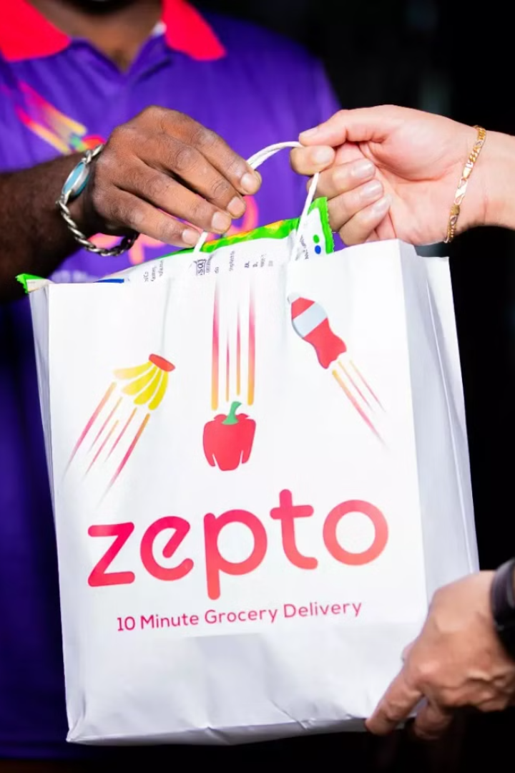
Expected Output : Total Sales by Fat Content
The expected output from the SQL query provides a clear overview of sales performance across different fat content categories. By comparing total sales, average sales, the number of items sold, and average ratings, Zepto can identify consumer preferences and trends.
Fat_Content
Total_Sales
Avg_Sales
Number_of_Items
Avg_Rating
Low-Fat
500000
250
2000
4.3
Regular-Fat
300000
200
1500
4.1
This data-driven approach ensures that Zepto’s inventory and marketing strategies align with actual consumer demand, maximizing sales and customer satisfaction.
Notes:
5

Slide 6

SQL Query: Total Sales by Item Type
This SQL query groups sales data by item type to identify popular product categories. It calculates total sales, average sales, the number of items sold, and average rating for each item type.
SELECT Item_Type,
SUM(Sales) AS Total_Sales,
AVG(Sales) AS Avg_Sales,
COUNT(Item_ID) AS Number_of_Items,
AVG(Rating) AS Avg_Rating
FROM sales_data
GROUP BY Item_Type;
Understanding top-selling item types helps Zepto improve product offerings and marketing to meet customer demand.
Notes:
6

Slide 7

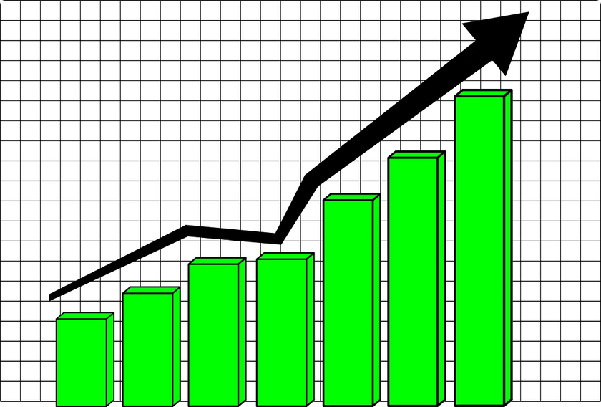
Expected Output: Total Sales by Item Type
The SQL query results show sales for each item type. This helps Zepto see which products sell best, how happy customers are, and how to improve inventory and marketing.
Item_Type
Total_Sales
Avg_Sales
Number_of_Items
Avg_Rating
Fruits
600000
300
2000
4.5
Dairy
250000
180
1400
4.0
Snacks
400000
220
1800
4.2
By looking at these numbers, Zepto can make better choices about what to sell, how to promote products, and how to grow sales.
Notes:
7

Slide 8

Key Insights from Analysis
Low-Fat Dominance
Low-fat items drive total sales, indicating demand for healthier options.
Fresh Produce Appeal
Fruits and vegetables generate the highest sales, emphasizing quality and availability.
Newer Outlet Success
Outlets established post-2018 show higher sales, suggesting effective strategy.
Medium Outlet Impact
Medium-sized outlets contribute 45% of sales, highlighting their strategic role.
Notes:
8

Slide 9





Conclusion & Next Steps
Comprehensive Understanding
The SQL analysis provides a granular understanding of Zepto's operational performance across multiple dimensions.
Strategic Optimization
Insights derived from the analysis facilitate the optimization of sales strategies, customer satisfaction, and revenue generation.
Actionable Implementation
Implement key findings to refine inventory distribution and customer engagement strategies for immediate impact.
Continuous Refinement
Ongoing analysis and refinement of strategies will ensure sustained business growth and competitive advantage.
Notes:
9

Slide 10
Thank You

